Slide 1
Sales Performance Dashboard in Tableau
Prepared by:
G .Mahalakshmi(DADS Feb Online batch-2025)
Project: Tableau Reinforcement Project

Slide 2
Dataset Overview
• Source: Sales Data Tableau 1.xls & hexmap.xlsx
• Attributes: Sales, Profit, Quantity, Discount, Region, State, Category, Sub-Category, Segment, Order Date, Ship Mode, Customer Name
• Hexmap.xlsx provides regional mapping for visualization
• Data cleaned and structured for analysis in Tableau

Slide 3
Dashboard Overviews
• Interactive Tableau dashboard created using sales dataset
• Includes charts: Sales by Category, Profit by Region, Trend Analysis, Hexmap Visualization
• Filters: Region, Category, and Date Range
• Tooltips and calculated fields added for deeper insights
• Designed for clarity and actionable insights

Slide 4
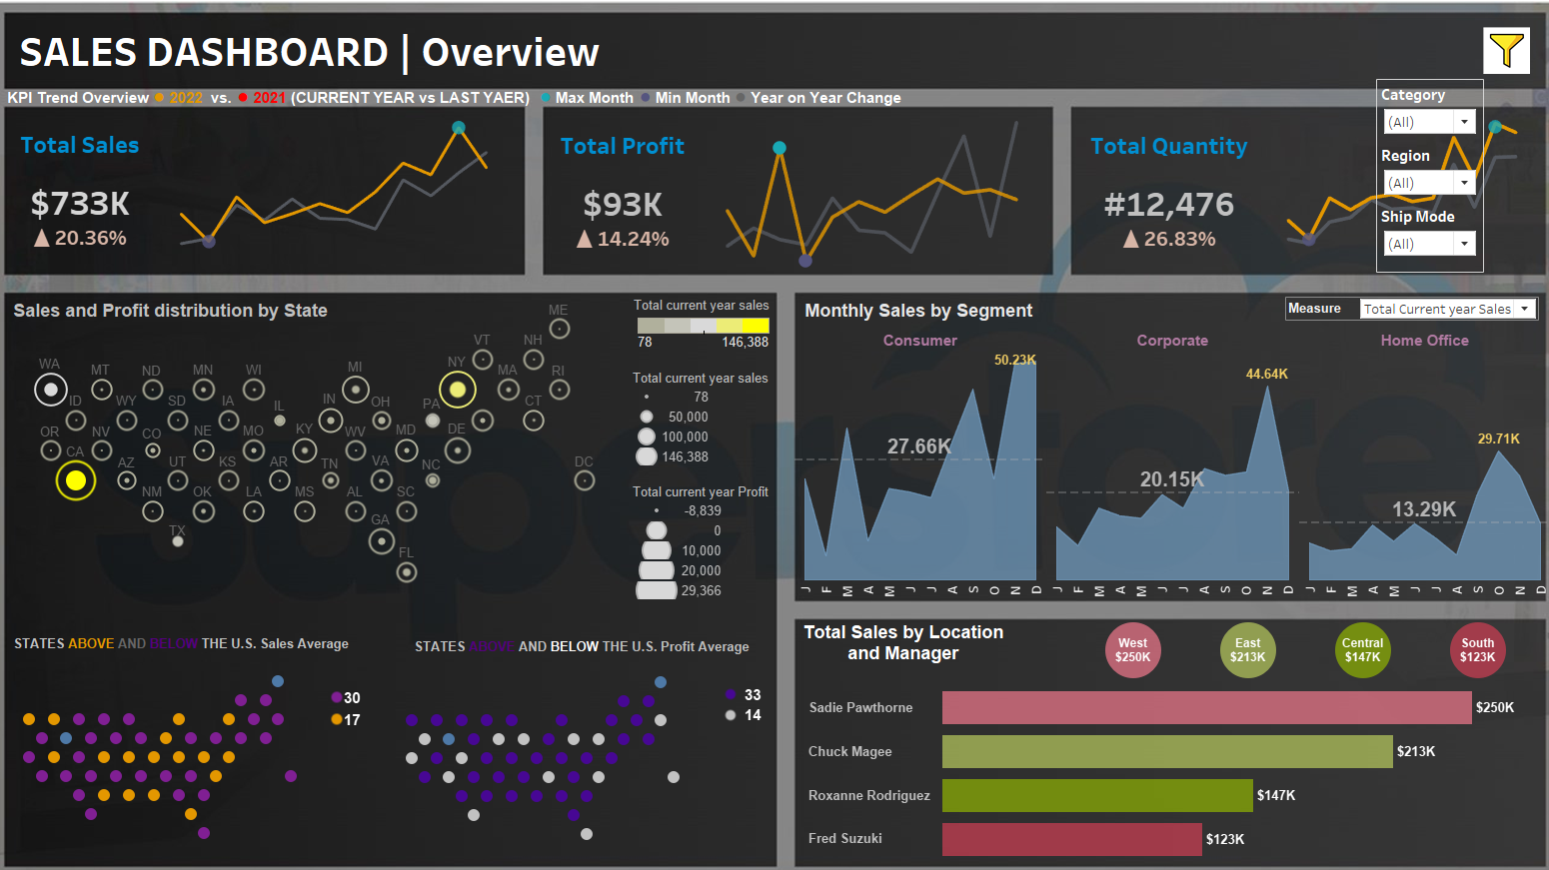
Dashboard

Slide 5
Key Insights
• Technology segment shows highest sales contribution
• Furniture category has high sales but lower profit margins due to discounts
• Western region leads in profitability, while some regions underperform
• Seasonal trends observed: strong sales in Q4
• Actionable Recommendation: Adjust discount strategy for Furniture; increase focus on profitable regions

Slide 6
Conclusion
• Tableau dashboard provides a comprehensive view of sales and profitability
• Data-driven decisions can enhance discount strategies and regional performance
• Real-world application: Helps management optimize sales planning, marketing, and inventory
• Future scope: Integrate real-time data for continuous monitoring

Slide 7
Introduction: The Business Challenge
• In today’s competitive market, sales data without insights is just noise.
• Goal: Transform raw data into an engaging dashboard.
• Managers can instantly understand trends, performance gaps, and make data-backed decisions.

Slide 8
Exploring the Data
• Dataset with 1,000+ transactions (Sales Data Tableau 1.xls & hexmap.xlsx)
• Attributes: Region, Category, Quantity, Profit, Shipping Mode, etc.
• Key business questions:
– Which regions drive the most revenue?
– Are discounts hurting profitability?
– What categories are underperforming?

Slide 9
Building the Dashboard
• Filters for Category and Region
• KPIs: Sales, Profit, Quantity
• Line charts for yearly sales trends
• Heatmap & Hexmaps for regional performance
• Designed for dynamic exploration in Tableau

Slide 10
Key Insights Found
• West region consistently leads in sales & profit
• Office Supplies underperform in profitability
• Corporate segment shows highest growth potential
• High discounts reduce margins in some categories

Slide 11
Strategic Recommendations
• Invest more in West region & Corporate segment
• Reassess pricing and discounts in low-margin categories
• Optimize shipping modes for cost efficiency
• Launch targeted campaigns by geography & segment

Slide 12
Conclusion: The Power of Visualization
• Tableau transformed raw spreadsheets into a clear story
• Patterns & trends are now visible and actionable
• Stakeholders can explore insights interactively
• Supports better planning, marketing, and inventory decisions

Slide 13
Thank You

